Slide 1
SPAC
Presenters:
Rama Camara Spasic –Director
Michelle Ward–Director

Slide 2
Contacts and Escalation
SPAC internal processes
General Information & Updates
Questions

Slide 3
Contacts & Escalation

Slide 4
Contact the billing teams :
Billing Inquiries- VMS Awards: billvms@umaryland.edu
Billing Inquiries- Fed Awards: billfed@umaryland.edu
Billing Inquiries- NON-FED/COST Awards: billnonfed@umaryland.edu
Billing Inquiries- LOC Awards: spacffr@umaryland.edu
Contact the Setup team : spacsetup@umaryland.edu
Contact the CAR team: spaccollections@umaryland.edu
Contact the Effort team: effort@umaryland.edu
Please send email to only one Email Inbox for faster resolution time.

Slide 5
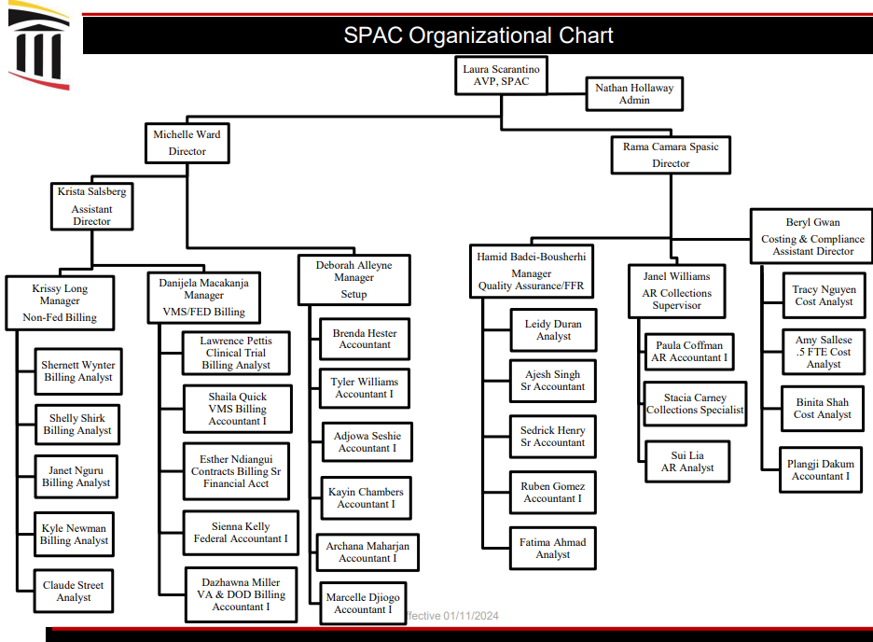

Slide 6
Not currently envisaging to have a 24 hours online chat room:
BUT:
SPAC Team is required to use Teams every day. Please reach out to the specific individual via Teams, if needed.
SPAC will have office hours (similar to SPA)starting February 2024
Twice a week.
Consecutive to SPA office hours.
More information will be communicated and posted on the SPAC website closer to 2/1/2024.

Slide 7
Response time for issues: please expect maximum 24-72 hours resolution (1-3 business days) depending on the severity of the issue.
Note: SPAC Team will be in a meeting all day on 2/8/24, therefore response time may be delayed on that day.

Slide 8
Internal Processes

Slide 9
Collections
Every quarter (March, June, September, December), SPAC Director sends the over 180 days aging outstanding receivable to Assistant Deans of schools.
Timely Reporting of FFRs
Within thirty (30) calendar days after the end of the project period, a draft FFR reconciliation based on the UMB financial system is sent to the Department Administrator or other designated individual.
The department will review the FFR for completeness and accuracy, process any adjustments, have the Principal Investigator (PI) sign the corrected FFR and return it to SPAC within 14 days.

Slide 10
If the signed FFR and any necessary documents are not returned within fourteen (14) calendar days, a second request is sent to the department and the PI.
If the signed FFR and any necessary documents are not returned within seven (7) more calendar days, a third request is sent to the department, PI and the Dean’s Office.
If the signed FFR is not returned within seven (7) calendar days with appropriate documentation and PI’s signature, the final federal report will be sent out based on the most recent UMB financial system report (not to exceed the budget) ,without department/PI approval.
Any additional expenses incurred after the submission of the final FFR without PI’s signature will be the responsibility of the department.
https://www.umaryland.edu/policies-and-procedures/library/financial-affairs/policies/viii-800a.php

Slide 11
Effort Escalation process
The SPAC Cost team will send emails monthly to the Department Chairs copying the Department Coordinators (DCs) and Sub DCs for delinquent effort forms over 90 days past due.
If effort forms continue to be outstanding over 120 days, an additional quarterly process will be done:
SPAC Director will have a first review and identify the ones that require a higher escalation notification
These forms will be sent to the SPAC AVP who will conduct a second round of review
Serious delinquent forms will then be escalated to the appropriate Dean and copy both the VP Finance and Auxiliary Services/Deputy CFO and the Chief Business and Finance Officer & Senior VP.

Slide 12
Effort Escalation Policy: https://www.umaryland.edu/media/umb/af/cost/Effort-Form-Escalation-Procedure-and-Resources.pdf
For Effort related questions and issues: Every Wednesday has been set aside to meet with departments to address all effort reporting needs. Send a calendar request with your questions and/or issue prior to the meeting to effort@umaryland.edu

Slide 13
F&A Rates FY 2024
The University has successfully negotiated a new Fringe Benefit and F&A cost rates with the federal government
Facilities and Administrative (F&A) Cost Rate Agreements - Costing and Compliance (umaryland.edu)
Uniform Guidance change: raises the MTDC (Modified Total Direct Costs) for subawards from $25K to $50K.
However, this change will not affect our F&A rates until the next negotiation in 2027.

Slide 14
Setup Process What constitutes a new award vs a new PID?
New Award
Change in a purchase order (PO) Number
Single - (VA)
Multiple PO’s on one award (BCPS)
Change in sponsor contract number (not adding the year at the end, the core # must change)
Change in Letter of Credit (LOC) document id number.
Change in Sponsor funding source (like LOC ID change – but this is a new funding window)
Change of PI from one org to another.
Continuations where sponsor will not accept cumulative billing or carryover is not automatic (NON LOC).
New PID
Continuation of another year if carryover is not automatic. (LOC)
Continuation where carryover is automatic but sponsor wants accounting of each budget year.
Supplement on an existing award – denoted by S
Child accounts - denoted by C

Slide 15
TEMP accounts - Key components for correct setup are:
Sponsor - Sponsor name is correct for billing purposes.
Source – how they are funded e.x. 315 Federal, 335 State and local, 375 Private – Federal Prime.
Science - is the function – purpose for which the costs are incurred – e.x,. 210 Research, 230 clinical trials.
Billing type - volume ( per patient etc) milestone ( upon completion) Cost ( as incurred) etc.
Link to Quantum chart to accounts for source and function definitions- https://www.umaryland.edu/quantum/chart-of-accounts/

Slide 16
Committed Cost Share( CCS) and Over the Cap (OTC) cost share.
OTC cost share– During award setup SPAC will automatically add the OTC designation for all awards funded through Department of Health and Human Services( DHHS) agencies except for FDA and ATSDR
For all other sponsors SPAC will not capture the OTC cost share unless the information is in the distribution tab of Kuali Research under the Institutional Proposal (IP) number.
https://www.umaryland.edu/policies-and-procedures/library/financial-affairs/policies/viii-9909a.php
CCS - SPAC will not enter during award setup unless it is populated in Kuali Research.
If CCS or OTC is required on an award that has already been setup, please send an email to the setup team.
You can view if cost share has been setup on your project by viewing the award in Quantum Financials under the award module. – searching for the award, then view under Projects (2) train-stop the funding source

Slide 17
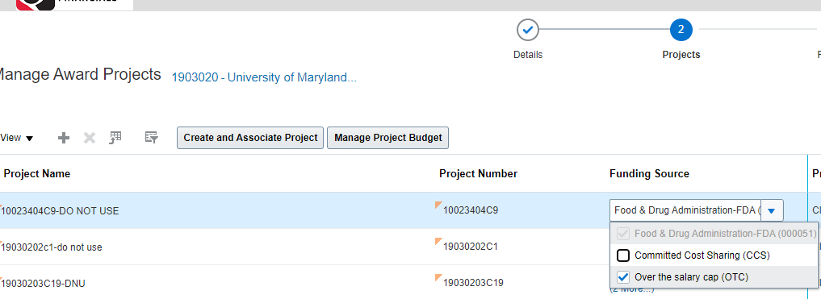
Reminder: OTC is captured at the org level while CCS is captured at the project level.

Slide 18
Billing
ROE and final billing
Turnaround time as indicated on the email received from your billing team. If not returned by the no later than (NTL) date, final invoice will be submitted with expenses as indicated in UMB’s financial system.
The signed ROE or FFR by the PI represents an agreement by the PI that these are the final charges for the project and/or award. Note: Any additional expenses over this amount will need to be funded by the department; or any expenses that fall below this report amount will need to be refunded to the sponsor in a timely manner. Department may seek approval from the sponsor for additional expenses, but it must all be done within the 60 -90 days after the project has ended.
SPAC cannot and will not re-open an award or project for further billing unless there is written approval from the sponsor.
Debit Memos or DRs for expenses that are over 1 year are not permitted, except with approval by SPAC Directors, Rama or Michelle.

Slide 19
Child Account Procedures- Request are made via a DocuSign form
https://www.umaryland.edu/spac/sponsored-projects-accounting-and-compliance-spac/forms/
Instructions are added to the website under Policies and Procedures.
Reminder:
Once the form is filled out and submitted, the requestor will receive an email prompting them to review. Once reviewed and closed, the form will continue along the routing process so that all parties can view the status.
To track the status, you must have:
A DocuSign account.
Must use a umaryland.edu email address.

Slide 20
General Information & Updates

Slide 21
OSN Replacement
As of May 2024, Oracle will discontinue Oracle Social Network (OSN)on the Quantum platform.
SPAC’s plan is to have the departments continue to create billing events in Quantum Financials but use an Image Now web form to submit supporting documents.
MORE TO COME IN THE NEXT MONTH.
Single Audit CliftonLarsonAllen (CLA)
Expect requests from auditors
Impacted departments will be contacted
Fellowships
Terminations letters are the closest thing to a financial closeout for fellowship awards. SPAC will be sending fellowship reconciliations to the department to assist in reviewing expenses and to use as support for the termination letters.
Please be on the lookout for the reconciliation within 30 days of the award end date.
Note: Termination letters are only used as financial reporting for fellowships not for training grants. For the latter, FFRs are used.

Slide 22
Policies Updates- approved September 2023
1)UMB Policy on SPAC Contract and Grant Billing https://www.umaryland.edu/policies-and-procedures/library/financial-affairs/policies/viii-800a.php
2) UMB Policy on SPAC Collections of Sponsored Receivables. https://www.umaryland.edu/policies-and-procedures/library/financial-affairs/policies/viii-800b.php

Slide 23
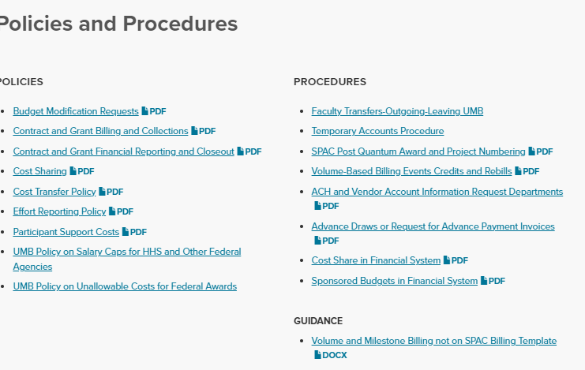
SPAC Procedures and Policies
Can be found here: https://www.umaryland.edu/spac/sponsored-projects-accounting-and-compliance-spac/policies-and-procedures/

Slide 24
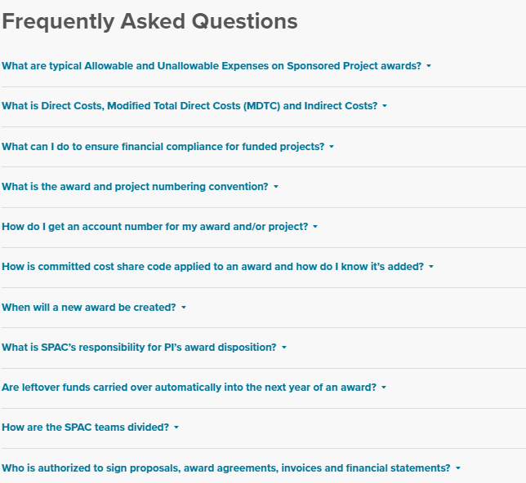
SPAC Frequently Asked Questions
Can be found here: https://www.umaryland.edu/spac/sponsored-projects-accounting and-compliance-spac/frequently-asked-questions/

Slide 25
QUESTIONS?

